Slide 1
ECE 4950 Project 1
Team 19 - Corey Golec, Jacob Criswell, John Phillips, Avi Patel, Josue Morales-Sanchez

Slide 2
How we completed the project
First met up to all introduce ourselves and talk about what areas we are proficient in
All 5 walked through the project together to see how we wanted to tackle it
Part 1
  After figuring out how Simulink works we were able to get the connection with the Arduino and potentiometer very quickly
Part 2
  Introduced us to constants and how the Servo motor takes in values
Part 3
  Combined the previous parts that we had working into one Simulink diagram

Slide 3
Team member Involvement
All 5 members were very involved throughout the entire project, here is what we all focused on:
3D Modeling
  John
Wiring up the Arduino and Servo
  Jacob and Josue
Simulink and MATLAB
  Corey and Avi
Report
  All members contributed
Very proud of the group and everyone worked with every part of the project but those were the main areas that we focused on

Slide 4
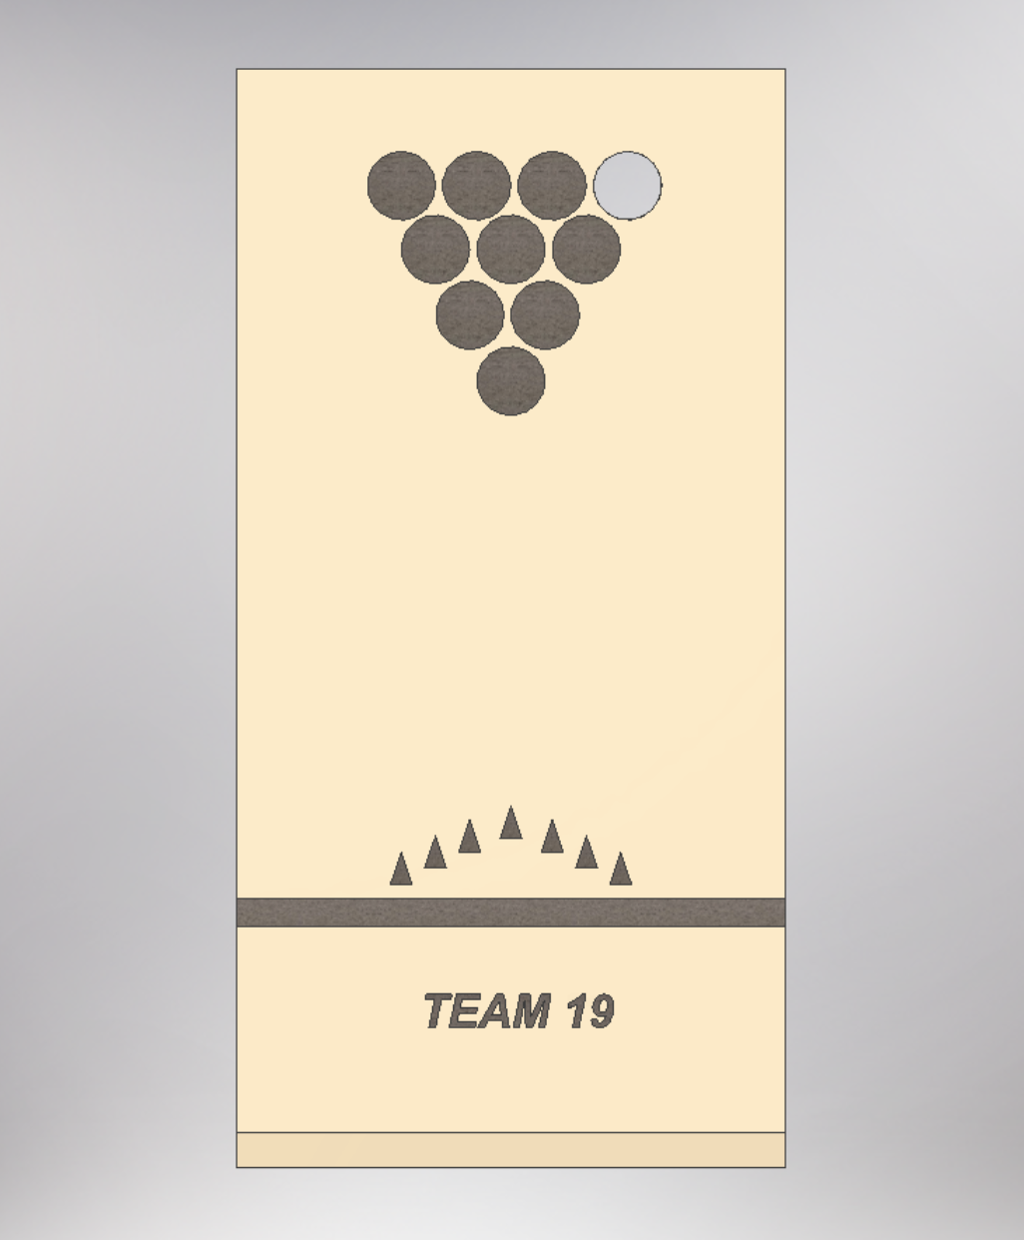
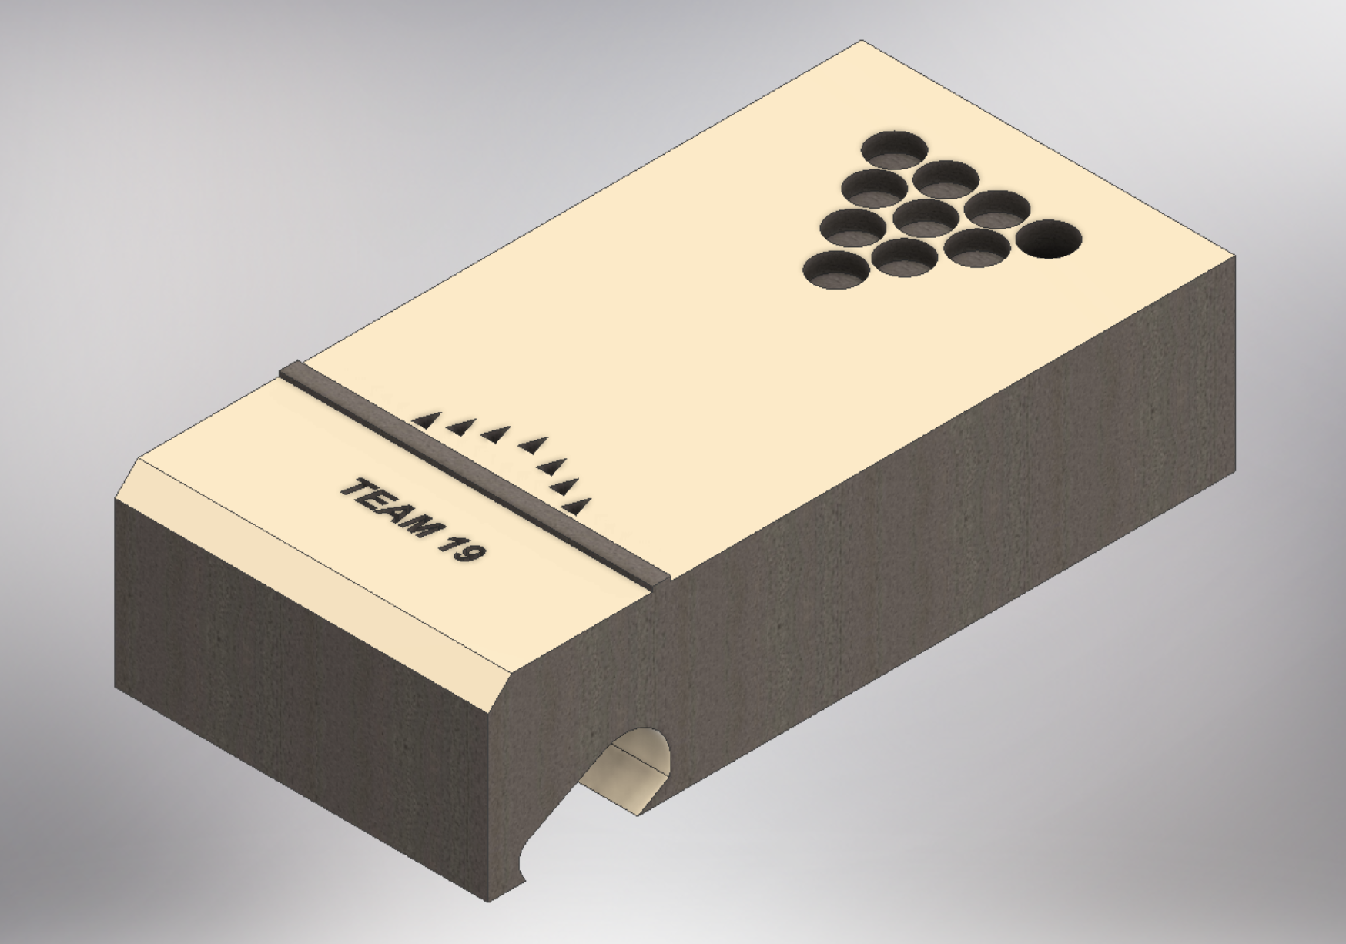
3D Designed Model

