Slide 1
The Big Lebowski:
Autonomous Bowling Robot
Group 19:
Corey Golec, John Phillips, Jacob Criswell, Avi Patel, Josue Morales-Sanchez

Slide 2
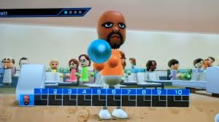
Executive Summary
This project, named ‘The Big Lebowski’ involves integrating several elements to create a functional robotic system that determines the location of multiple pins and drops a metal ball to knock them over. The project must be able to demonstrate bowling a strike (knocking over all the pins) as well as a spare (knocking over a subset of pins in random locations). Ultimately, the following design was implemented:
System supports manual (user-chosen pin) and automatic (algorithm-chosen optimal pin) targeting for strikes and spares.
Uses a camera, MATLAB App GUI, MATLAB/Simulink, and an Arduino Mega 2560 to control a DC motor–driven ramp and servo.
Built with the provided game board and electronics plus low-cost extras (<$300), including 3D-printed parts, guard rails, and a cardboard ball catch screwed on a rigid wooden base for safety.
Full cycle from pin selection to launch and return to idle is ~10 seconds, with GUI response times under 2 seconds, meeting performance and safety requirements.
A constantly updated website with documentation on hardware (including wiring), software (with full code), and update pictures and videos so that the design is recreatable and easy to understand

Slide 3
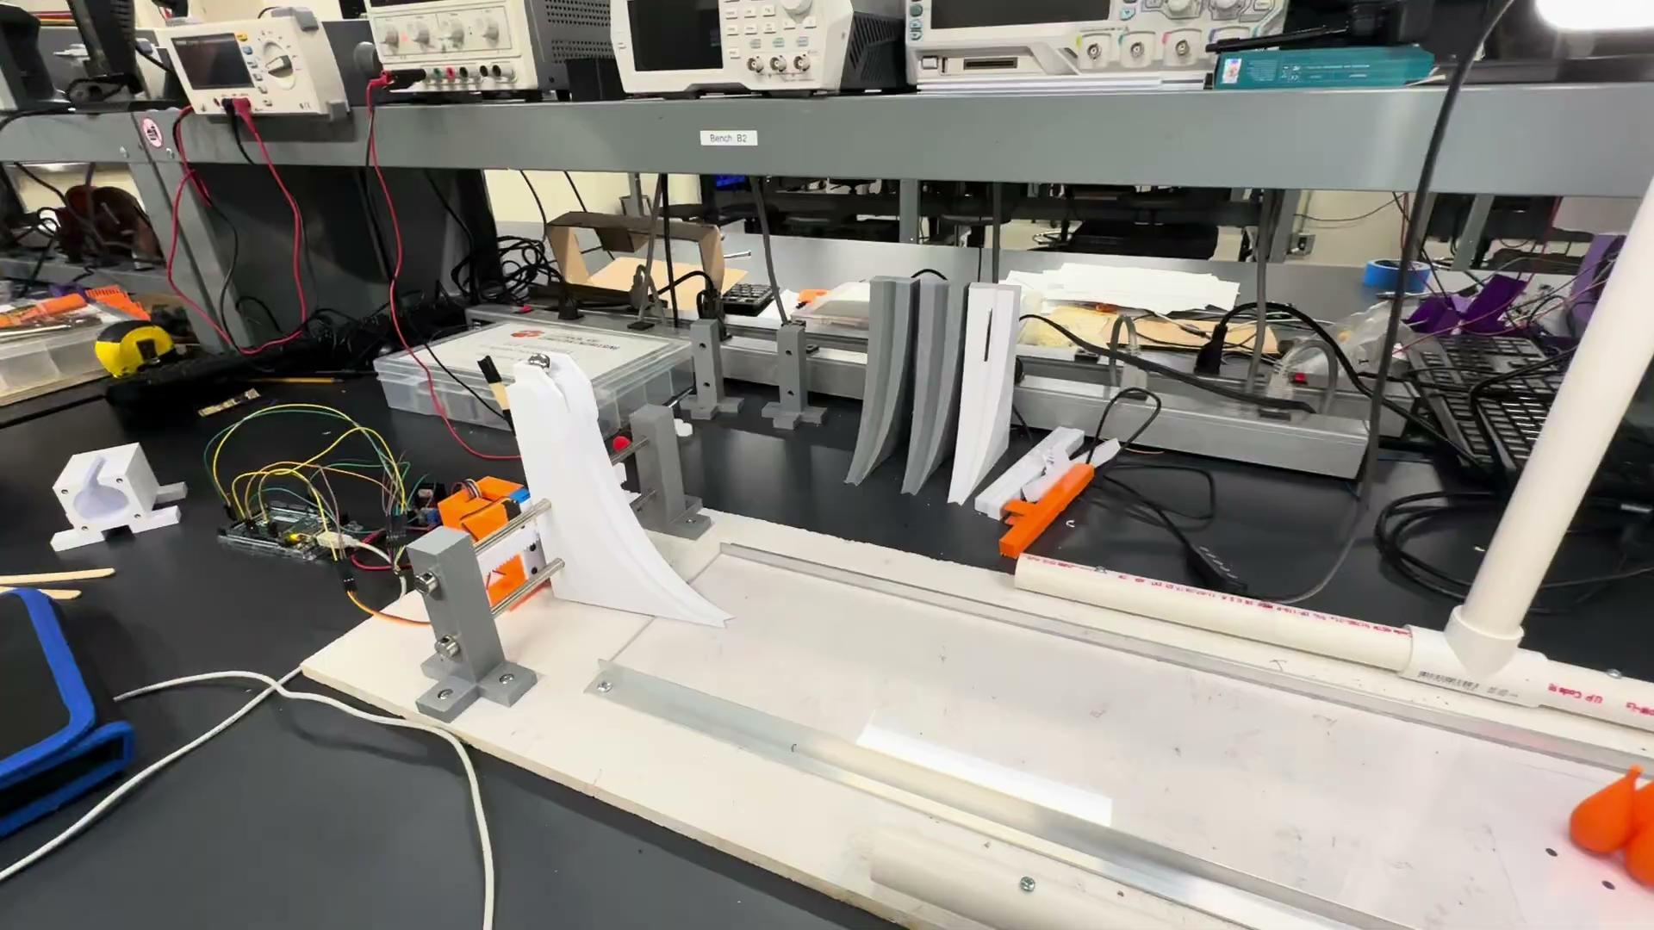
Demonstration Video

Slide 4
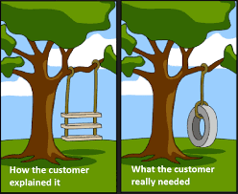
Customer & Engineering Requirements
Customer Requirements:
The robot plays the game according to the rules which are provided in a separate document.
Uses the provided game stage, electrical and mechanical interfaces.
Costs <300
Use the provided Arduino, camera, and DC motor (option to use other provided components).
Power source for custom electronics (beyond the standard computers and peripherals such as the USB camera.
No batteries
Reliable, Safe, and Durable
Low noise – no hearing protection required
Guarding as necessary to protect users
Fast solving times
Easy to use/user-friendly
Electric/electronic circuits built from off-the-shelf components.
Runs autonomously – user places their own pieces
Must have at least one degree-of-freedom that has closed loop position control using the provided DC motor where the loop is closed through the Arduino.
Engineering Requirements:
Ensure system is 100% rule compliant during runtime
Construct system based with provided game board and electronics, ensuring other components used total less than $300
Design system such that electronics need no batteries, and are powered via external 12V power supply or wall outlet
Ensure system reliability by verifying 95% success rate on bowling attempts
Ensure system reliability by verifying the system can run over 10 separate frames back-to-back without any intervention
Design system without pinch points, sharp edges, or exposed wiring to protect user
Implement system rails and ball catch to guard user from ball during system runtime
Avoid loud materials, components, or system configurations to prevent maximum system noise level from reaching above 70 dB (barrier for hearing damage)
Implement a clean and simple graphical interface with low latency and quick system response times of less than 2 seconds at user interaction
On user selection, quickly and efficiently target and bowl on target pins, with less than 10 seconds passing between user selection and the system’s return to idle

Slide 5
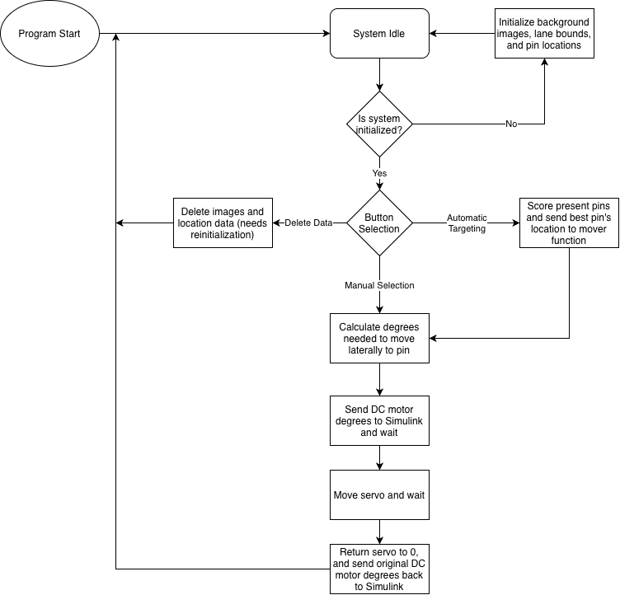
Software Explanation
Pin detection using HSV
  Detects specific pixel saturation
Presence and location of pins stored
Degrees needed for lateral movement calculated based on pin location
Degrees are sent to Simulink to move both DC motor and servo

Slide 6
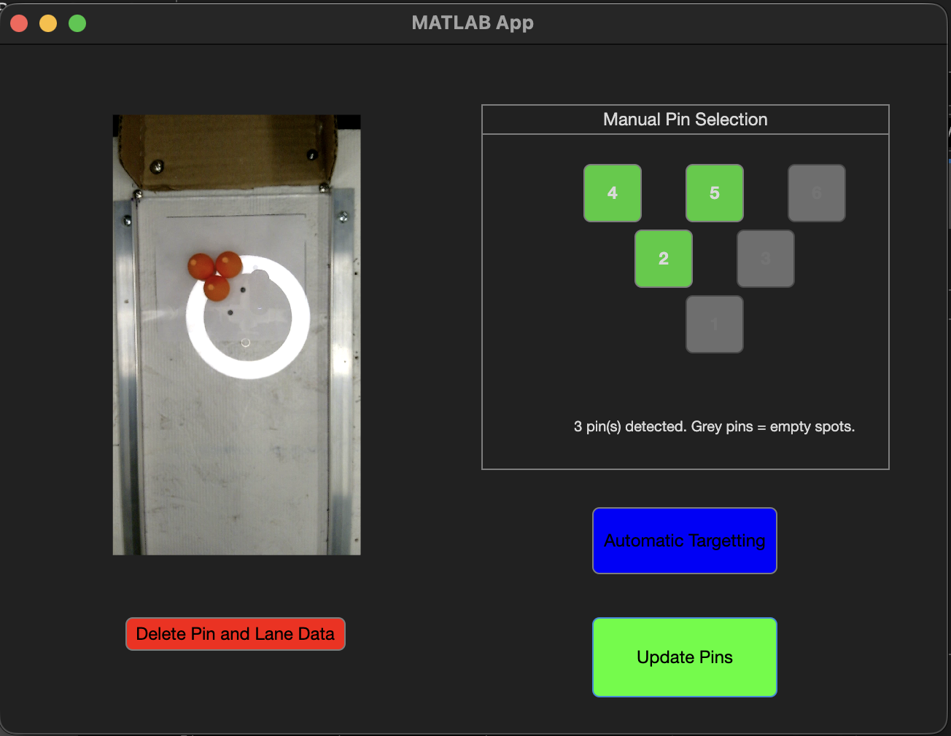
Performance Analysis
Accurate pin detection
Reliable software loop
  Didn’t need any intervention across 20 back-to-back frames
Consistent bowling cycle of less than 10 seconds
95% accurate pin hits across 20 back-to-back frames
Automatic detection detected best action with 100% accuracy across 20 back-to-back frames
GUI is clean and easy to use

